Slide 1

Secure Chat App
Arjun Khandala 21SOECE13035
Meet Mehta 21SOECE13044
Met Mori 21SOECE1348
Nihar Savaliya 21SOECE13064

Slide 2
Requirement Specification
User Interfaces
The customer user interface should be intuitive.
GUI is User-friendly.
App give appropriate error message

Slide 3
Hardware Interfaces
The hardware should have following specifications:
Ability to run the Latest Version of Application.
Ability to use Network resources
Continuous power supply and network supply

Slide 4
Software Interfaces
The Software interfaces are specific to a proprietary, encrypted instant messaging client.
The provision here is the keep the external software commination interface as seamless as possible.

Slide 5
Safety Requirements
User data are store in encrypted form.
Security Requirements
Messages shared between users should be encrypted to maintain privacy
Software Quality Attributes
The mobile app should have a responsive layout and should be portable. The mobile app should follow recognition rather than recall i.e. it is simple and easy to use and learn

Slide 6
Communications Interfaces
Protocols would be required for secure communication and message encryption.

Slide 7
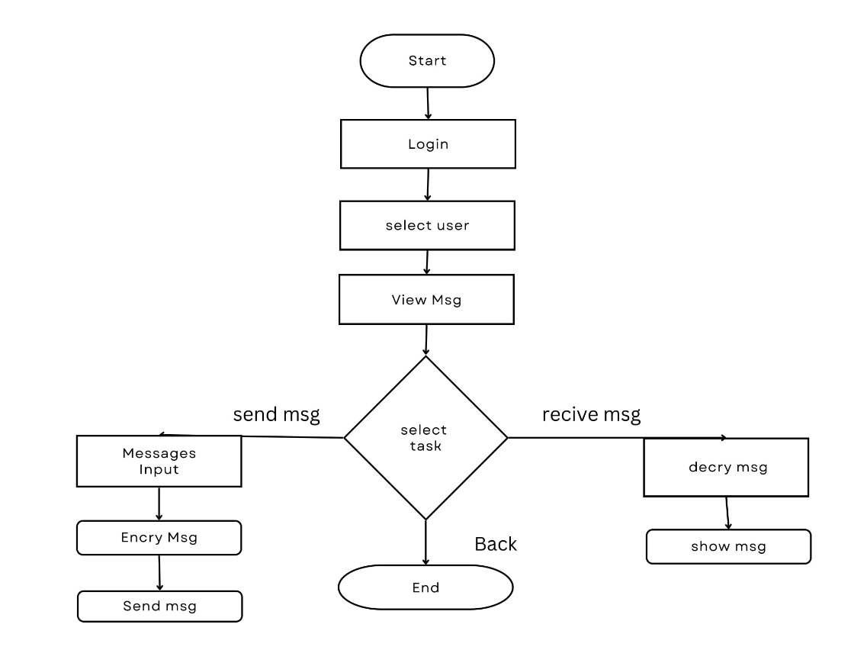
Flow Chart

Slide 8
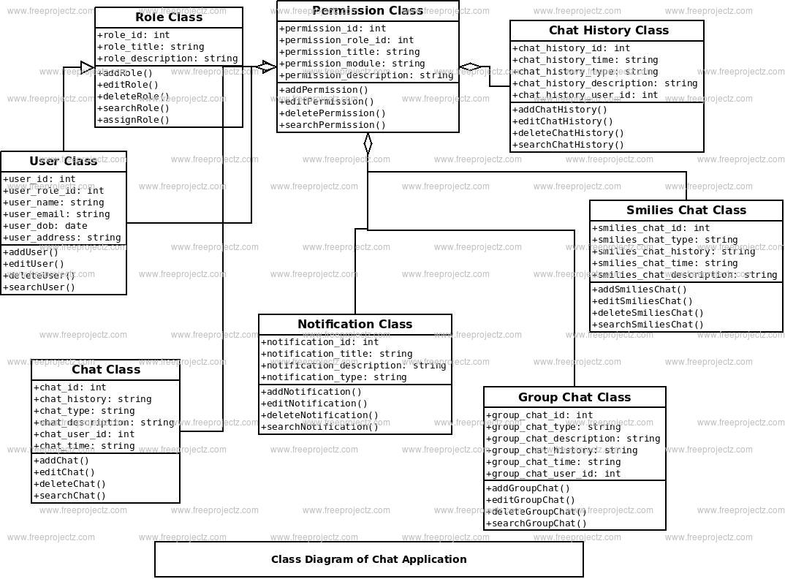
Class Diagram

Slide 9
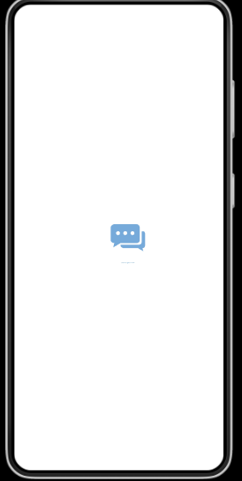
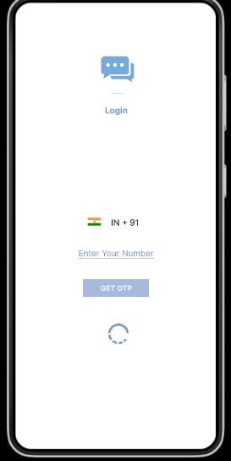
Wireframes

Slide 10
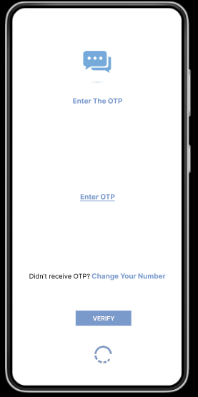
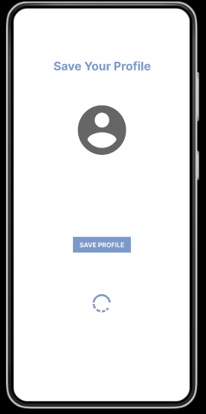

Slide 11
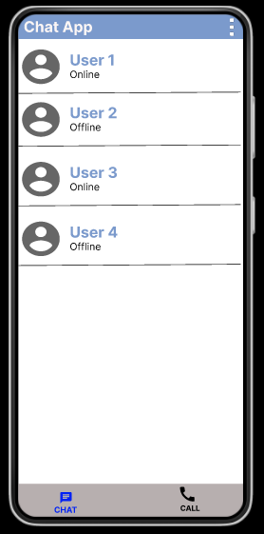
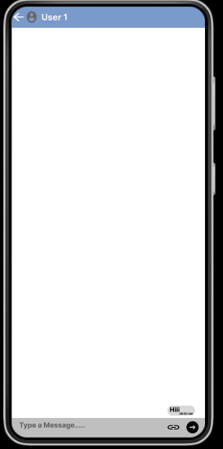

Slide 12
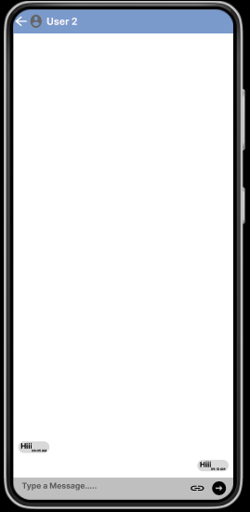
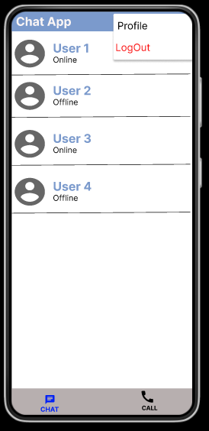

Slide 13
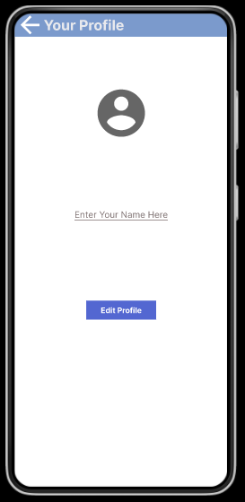
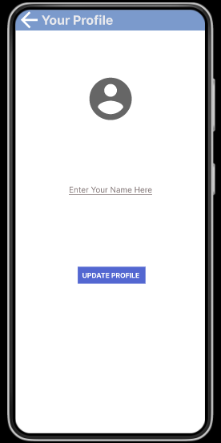

Slide 14
Implementation of Activity
Splash Screen
Main Activity
OTP Verify
Change Number
Profile
Chat Activity
Edit Profile
Notification

Slide 15
Implementation of Activity
Splash Screen
This Activity is Waiting some 3 sec. than New Activity Load.
The Splash Activity Use Handle Class.

Slide 16
Implementation of Activity
Main Activity
This Activity is User Enter Phone Number And Go To a New Activity.

Slide 17
Implementation of Activity
OTP Verify Activity
This Activity is User Enter Phone Number than send message For OTP verify.

Slide 18
Implementation of Activity
Change Number Activity
This Activity is User Can Wrong Number Enter Than Change a And new Number Editing.

Slide 19
Implementation of Activity
Profile Activity
This Activity is User Verify The Number Than Set Profile.

Slide 20
Implementation of Activity
Chat Activity
This Activity is User Chatting Some Other User.

Slide 21
Implementation of Activity
Edit Profile Activity
This Activity is User Profile Edit.

Slide 22
Implementation of Activity
Notification Activity
This Activity is User can Message Sent a second user than get a notification Show in your device.

Slide 23


